Slide 1
UPGG Bootcamp Day 2
Data Visualization

Slide 2
Poor Plot habits make confused findings

Slide 3
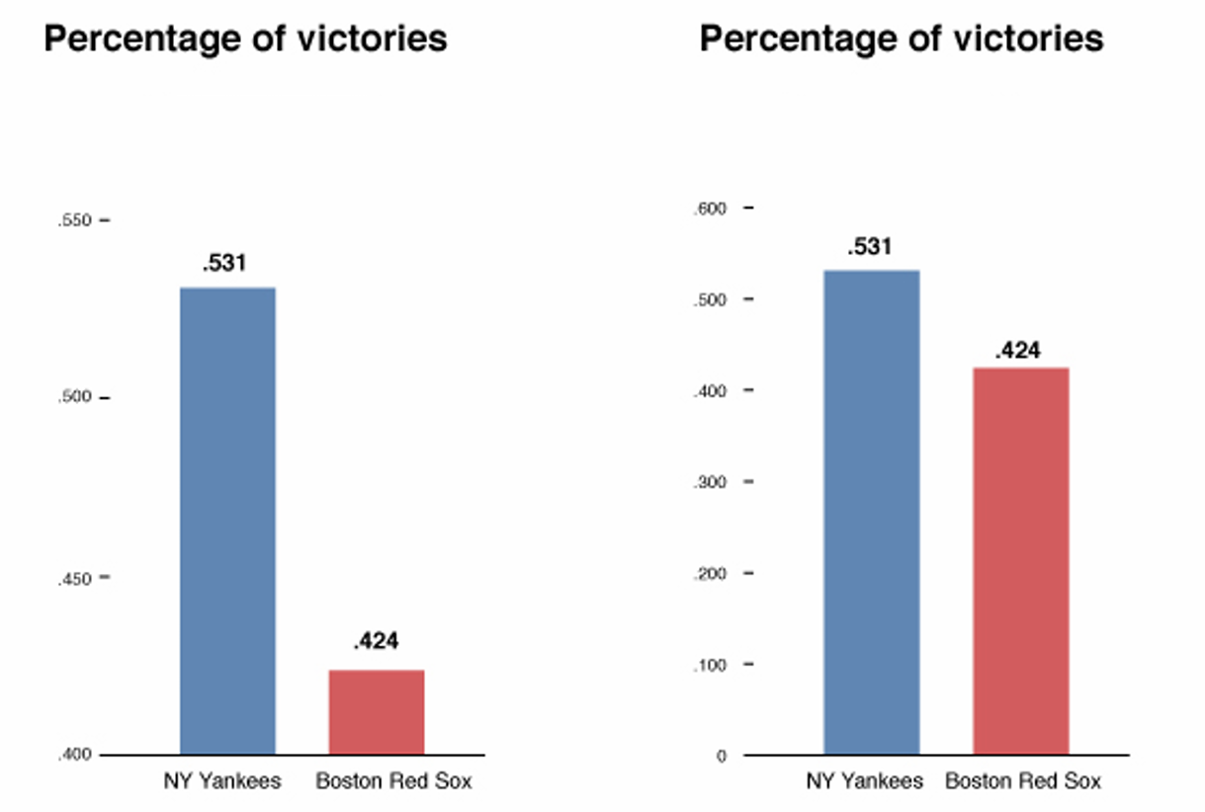
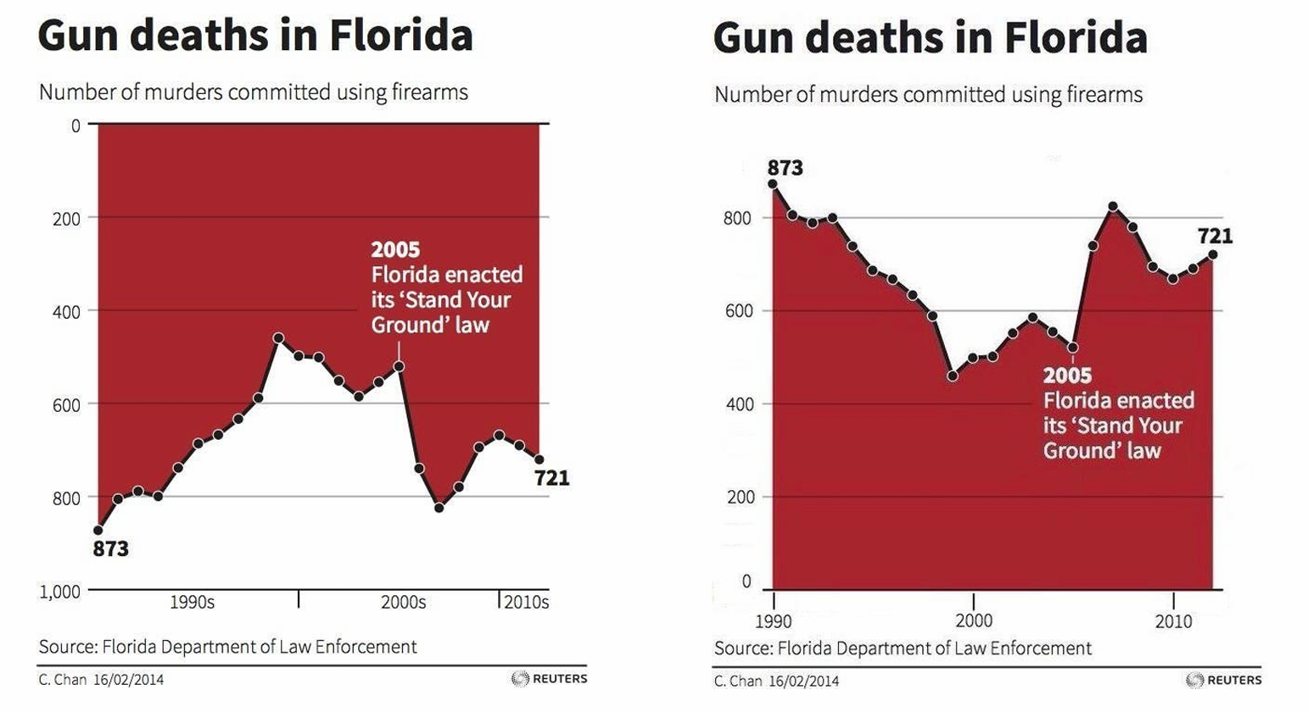
Poor Plot habits make confused findings

Slide 4
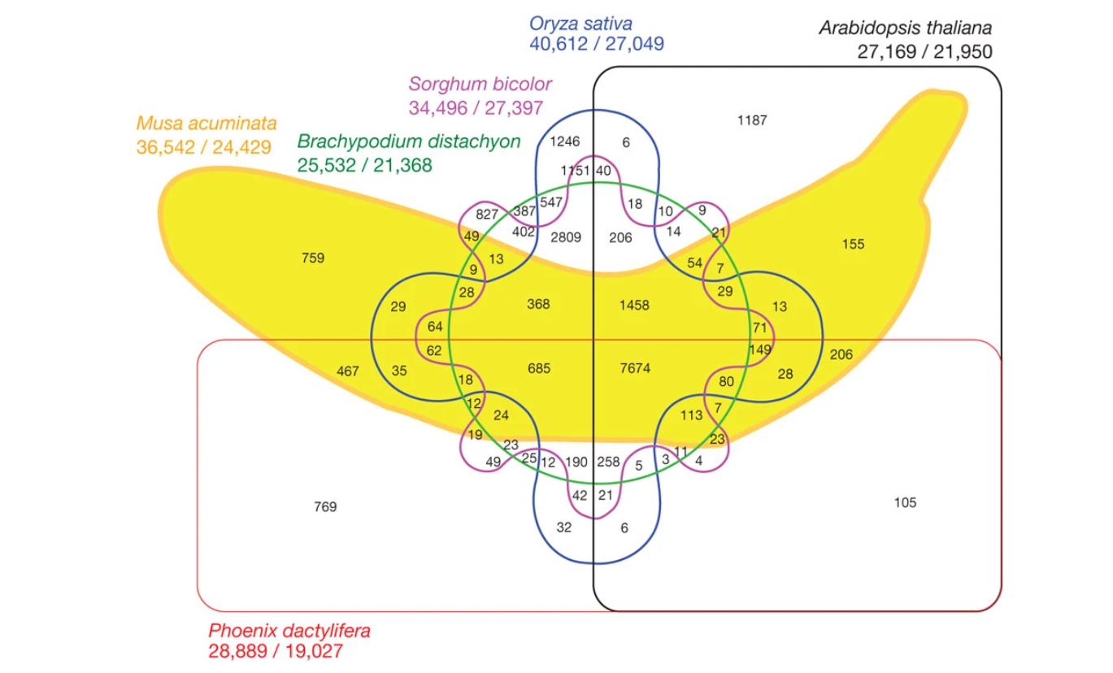

Slide 5
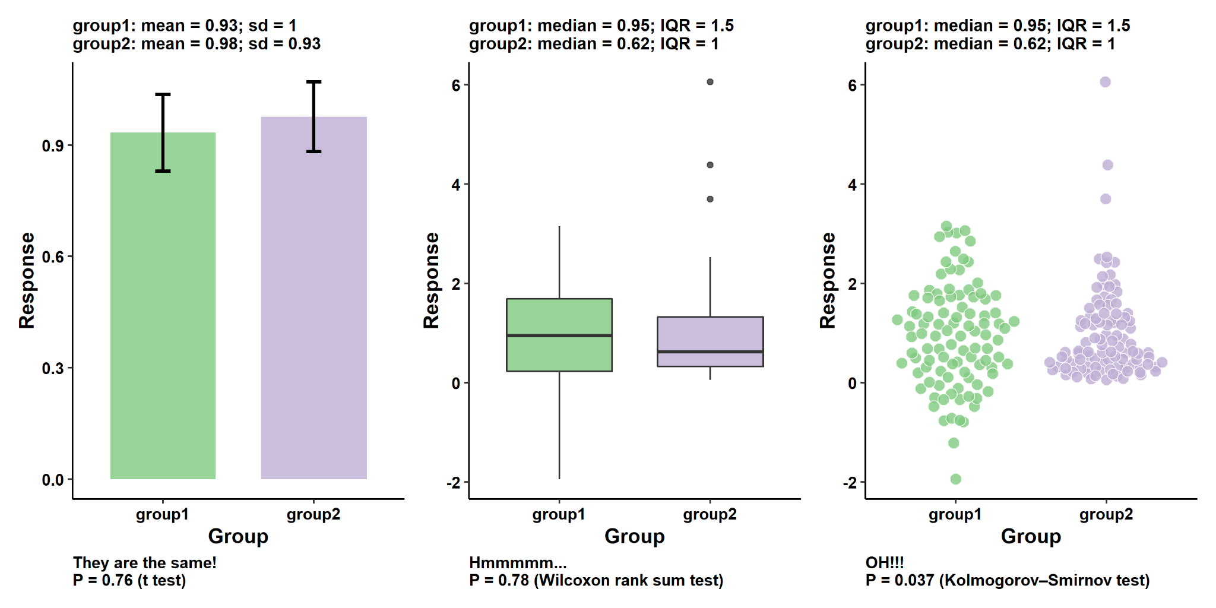
Why are Data Visualization skills Important?
Chenxin Li, 2024, GitHub - cxli233/FriendsDontLetFriends: Friends don't let friends make certain types of data visualization - What are they and why are they bad.

Slide 6
Good Graphical Practices
Information should be conveyed:
Clearly: the focus is on the data
Accurately: no distortions, distractions, or critical omissions in the data presented
Intuitively: with minimal need for explanation
Revealingly: uncovers trends and organization in data; ideally leads to insight
Engagingly: invites the viewer to think about what results mean
Consistently: orientation, scale, color, font, encodings, expected location, etc.
Relationally: connects to the overall narrative and to other visuals

Slide 7
Graphical Plotting In R
Traditional graphics treats each type of plot separately
Many different functions, each with distinct syntax and arguments
Hard to learn and remember; hard to read / update code later
Hard to experiment with different plot types
ggplot2 is built around the idea of a “grammar of graphics” (Wilkinson 1999)
Core concept: define plots based on semantic components
Important advantages:
Uses consistent syntax and arguments for all plot types: easier to learn / code
Allows combination of plot types through layering, multiple plots through faceting
Provides customizable themes: consistency is easier for audiences / readers to follow

Slide 8
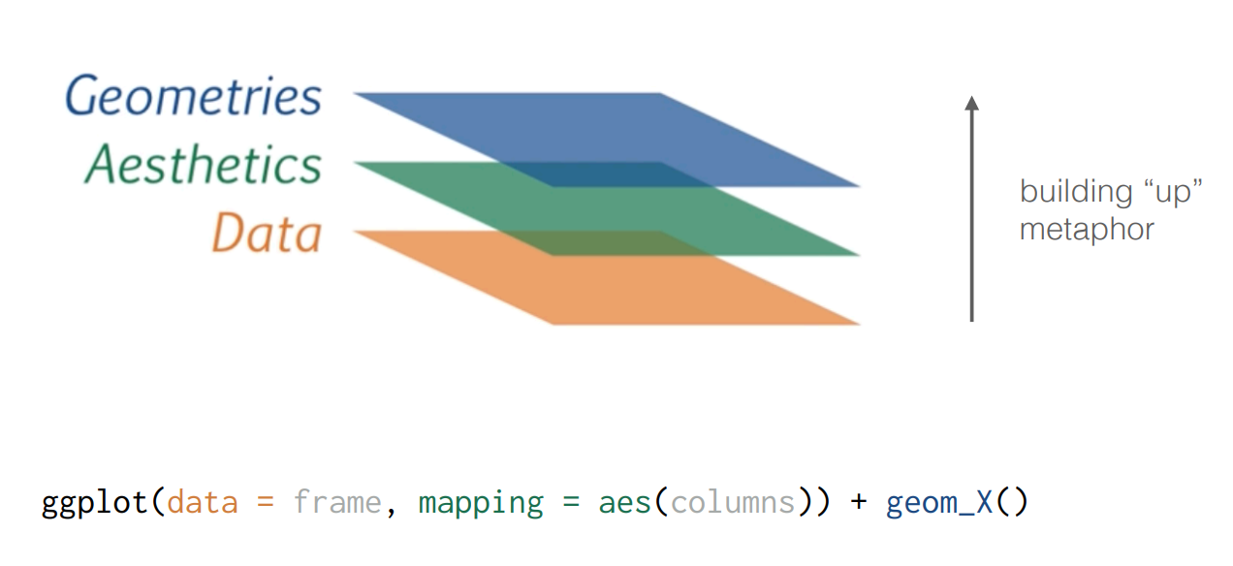
Working in layers

Slide 9
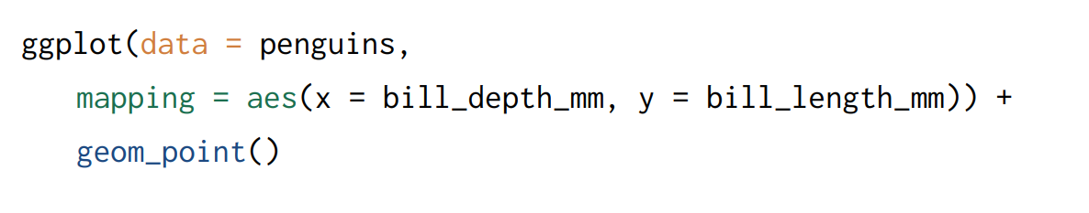
Working in layers

Slide 10
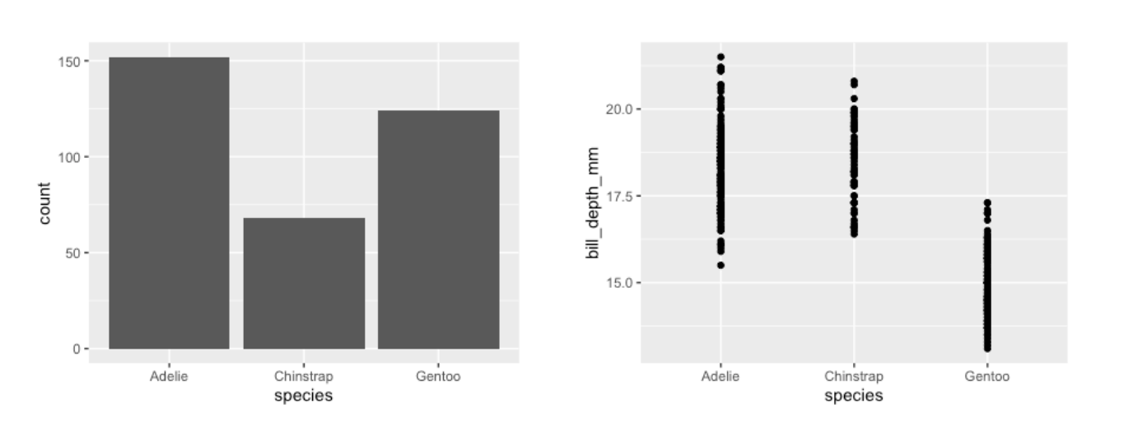
aes layer - one variable vs. two variables
Y-axis defaults to counts when supplying only one variable to a barplot
ggplot(penguins,
aes(x = species, y = bill_depth)) +
geom_point()
ggplot(penguins, aes(x = species)) +
geom_bar()

Slide 11
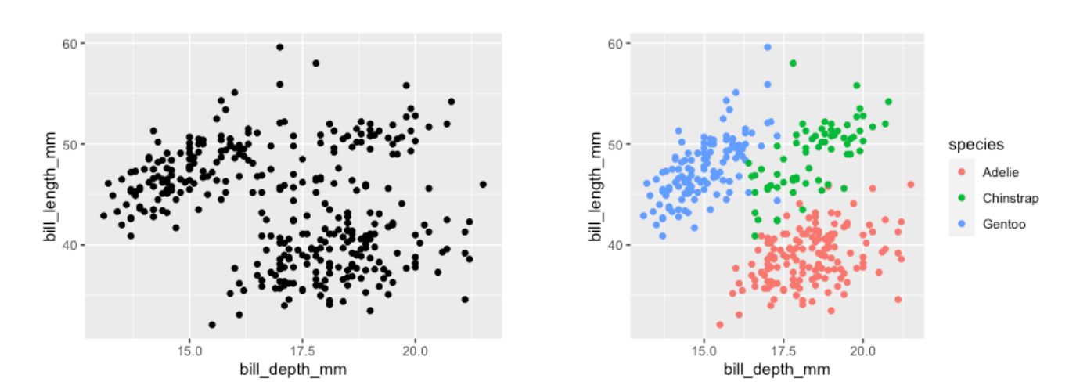
Three variables - color!
ggplot(data = penguins,
aes(x = bill_depth_mm, y = bill_length_mm, color = species)) +
geom_point()

Slide 12
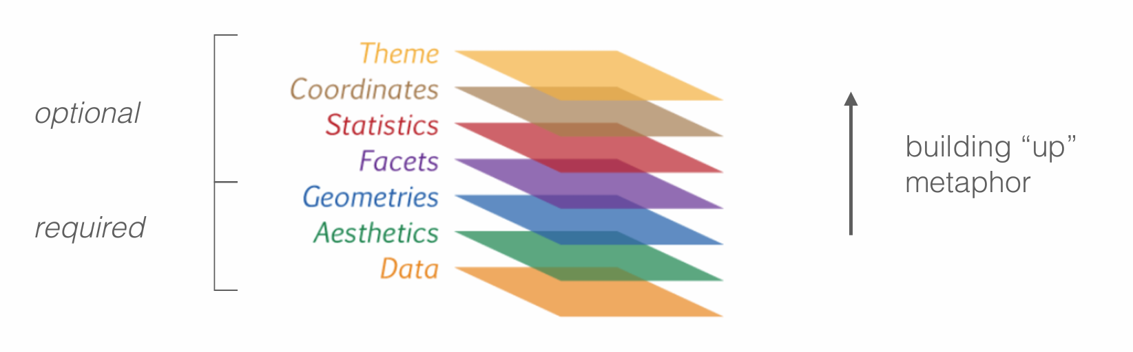
Optional (But extremely useful) Layers
Theme: every part of the graph not related directly to data; the “look and feel”
Coordinates: how variables are mapped, scaled, and applied to a particular geometry
Statistics: calculations of derived values; linked to specific geoms Image credit:

Slide 13
GGPlots Examples (with dataset)
Using data visualization to get a better idea of the data that you have
Simple scatterplots
Boxplot (based on groups, include with and without jitter) + Violin plot for comparison
Density plots
Histograms
Barplot
Pie chart
Testing output

Slide 14
More details
Adding stuff to plots
Adding colors carefully - reference colorblind tools
Adding titles etc.
How to change shapes
How to mess with axis ticks/labels
Facets
Stats
Scales
Patchwork for when plots are too different
Change legends
Making things easier:
Introduce ggraptR and esquisse tools later - you don’t need to remember everything
Ggpubr
Making things harder:
Fancy themes and ggh4x for forbidden techniques
https://teunbrand.github.io/ggh4x/
Custom themes and functions

Slide 15
Goals and next steps
Open ended questions
Specific fancy plots for genetics
UMAP/PCA/dimensionality reduction
Manhattan plots (GWAS/QTL)
Survival curves
Chromosome painting/read depth?
Phylogeny, admixture, pedigrees, etc.?
Volcano plots, venn diagram for gene regulation
Map overlays
Circos plots
UpSet plots
Polishing things up
BioRender for useful graphics and workflows (Duke departmental subscriptions)
Adobe Illustrator for creating and editing vector graphics + formatting (free for Duke students)

